Slide 1

Data Control/Security [using psycopg2]
Sean Davern
Notes:
Not an expert!

Slide 2

Motivation
Working with Page Ahead – Children’s Literacy Program
Notes:
non-profit literacy program
One service provides books to children for summer reading. They get to select the books and they get them for free.
In exchange for the service, the Seattle Public School system provides access to testing student testing data.

Slide 3
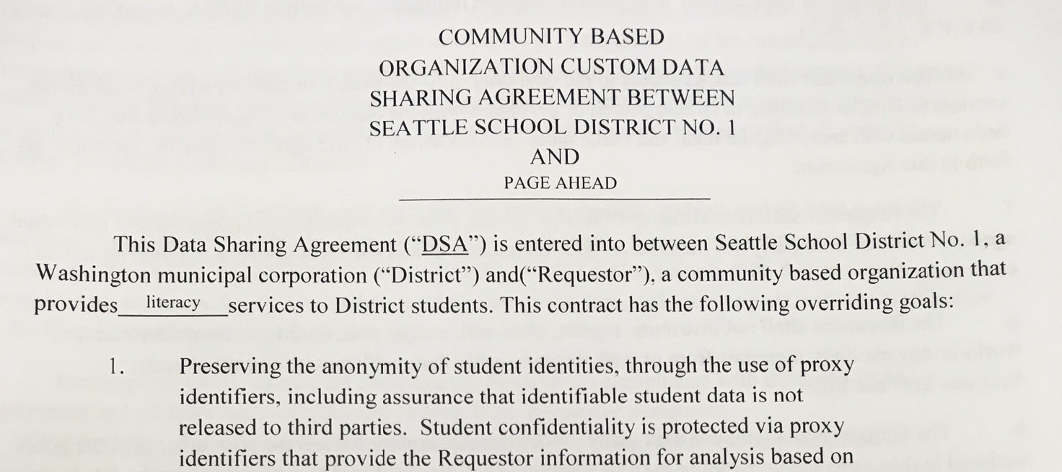
Motivation
Working with Page Ahead – Children’s Literacy Program
Page Ahead is bound by a Data Sharing Agreement

Slide 4
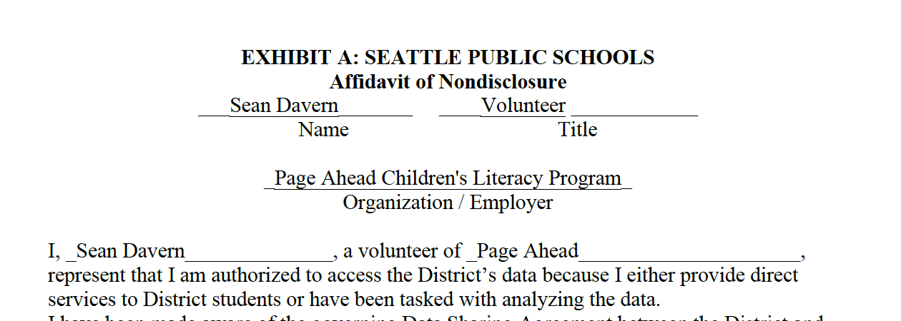
Motivation
Working with Page Ahead – Children’s Literacy Program
Page Ahead is bound by a Data Sharing Agreement
I’m bound by a Data Sharing Agreement with Page Ahead
Notes:
My obligation:
”Take reasonable security precautions and protections to ensure that persons not authorized to view the data do not gain access to the data, as outlined in the Data Sharing Agreement;”

Slide 5
Scenario Considerations
Data at rest
Google, AWS and on my computer
GitHub (use .gitignore files)
In Jupyter Notebooks
Data in transfer
Google Drive to my computer (Use HTTPS)
my computer to AWS (Use scp)
Jupyter Notebook and AWS (psycopg)
Notes:
TLS is Transport Layer Security
SSL is Secure Sockets Layer, developed by Netscape
SSH is Secure Shell
HTTPS uses TLS
SCP uses SSH (not SSL/TLS)
(difference between SSH and SSL/TLS: https://www.jscape.com/blog/ssl-vs-ssh-simplified)
TLS vs SSL: https://www.hostingadvice.com/how-to/tls-vs-ssl/

Slide 6
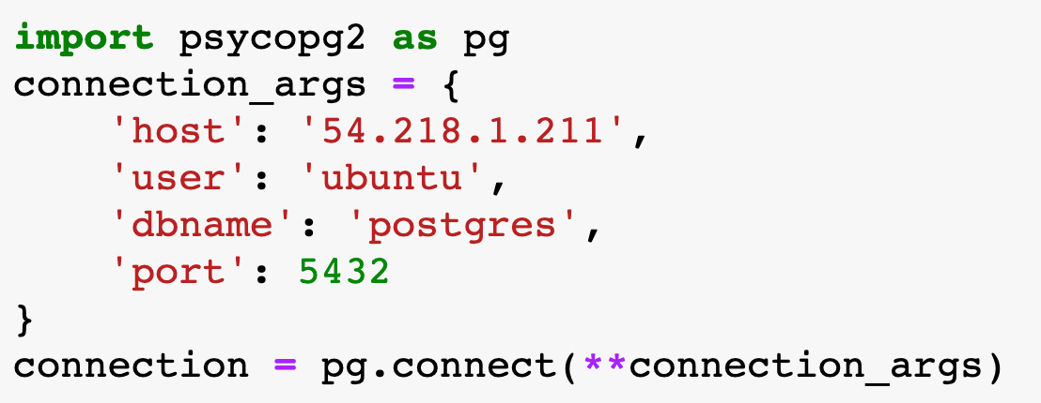
psycopg2
The most popular Postgres adapter
Wrapper for libpq
Is it secure?
Notes:
Name: psycho Pig or psyco p g
libpq is the C application programmer's interface to PostgreSQL. libpq is a set of library functions that allow client programs to pass queries to the PostgreSQL backend server and to receive the results of these queries.

Slide 7
Live Demo

Slide 8
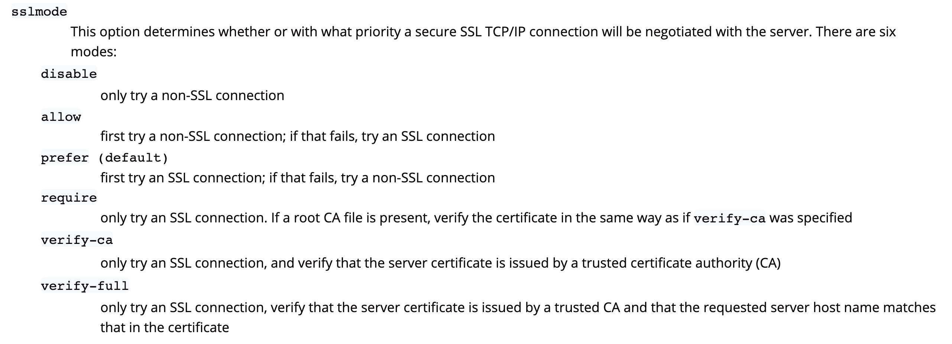
Connection sslmode
Notes:
This is from the Postgresql documentation for libpq: https://www.postgresql.org/docs/current/libpq-connect.html

Slide 9
Conclusion
Is psycopg2 secure?
It DEPENDS! It CAN be!
SPECIFY and VERIFY if it’s important!

Slide 10
Questions?

Slide 11
Appendix

Slide 12
Data-in-motion encryption
Source
Notes:
source: https://www.jscape.com/blog/ssl-vs-ssh-simplified

